Slide 1
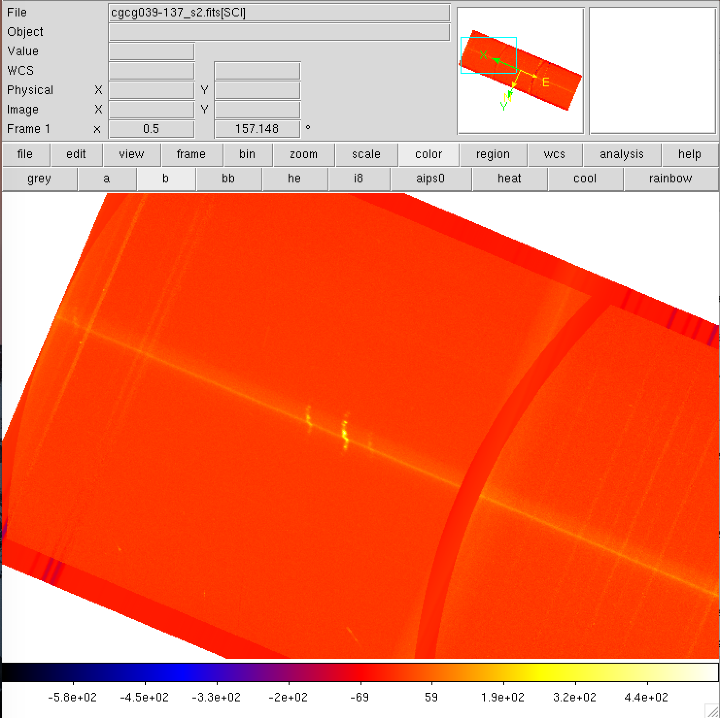
Red side
Blue side
Increasing wavelength
Notes:
Corrected (11/2017)

Slide 2
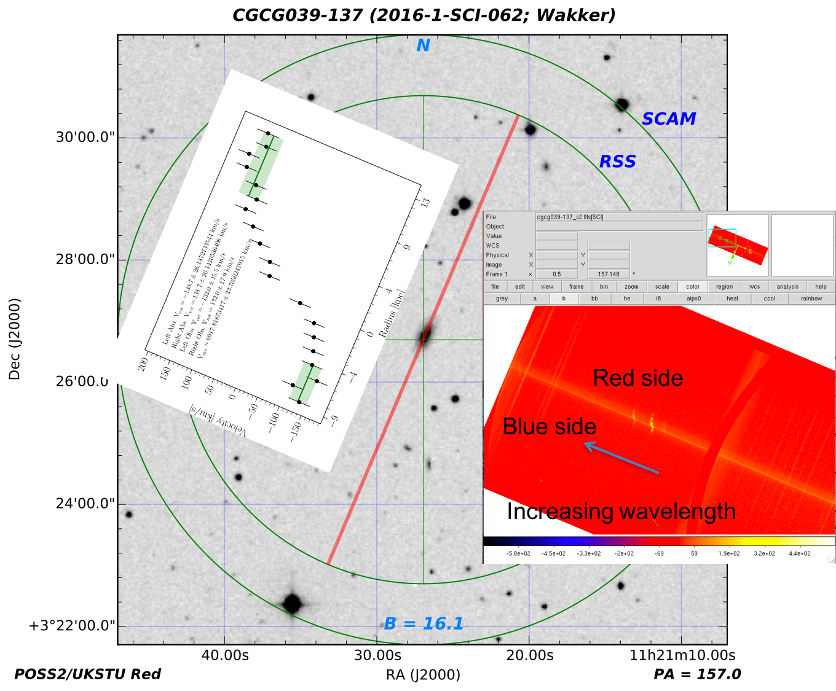
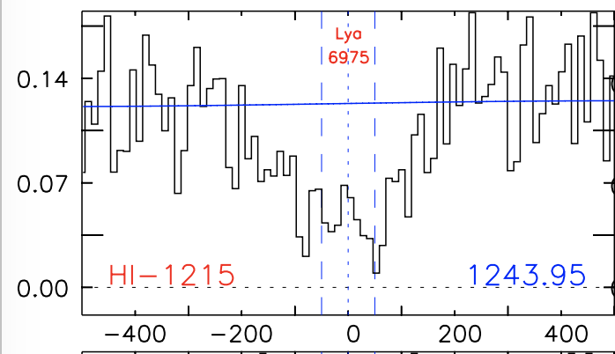
+132 km/s
-132 km/s
Nothing
dv = -211 km/s
Notes:
Corrected (11/2017)

Slide 3
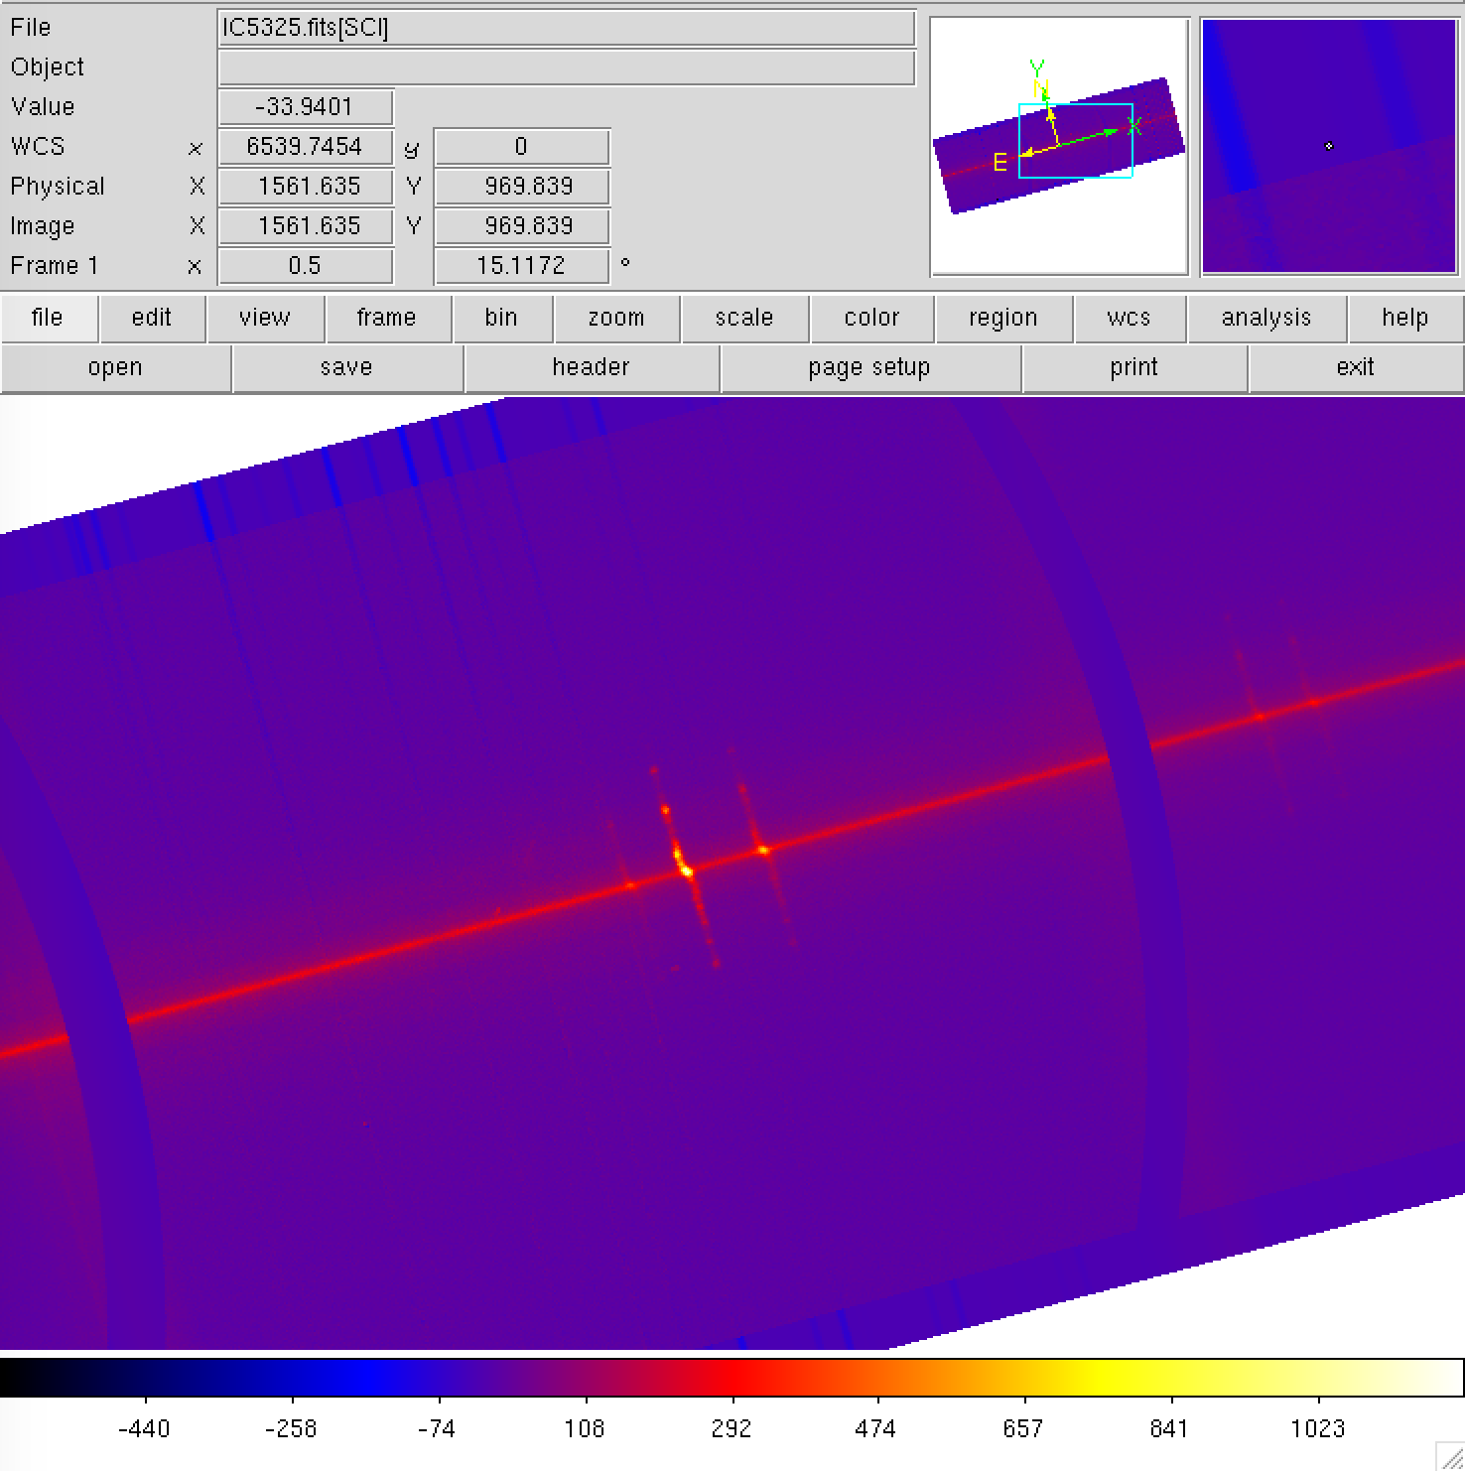
15 deg rotated
Blue side
Red side
Increasing wavelength
Notes:
Correct (11/20/17)

Slide 4
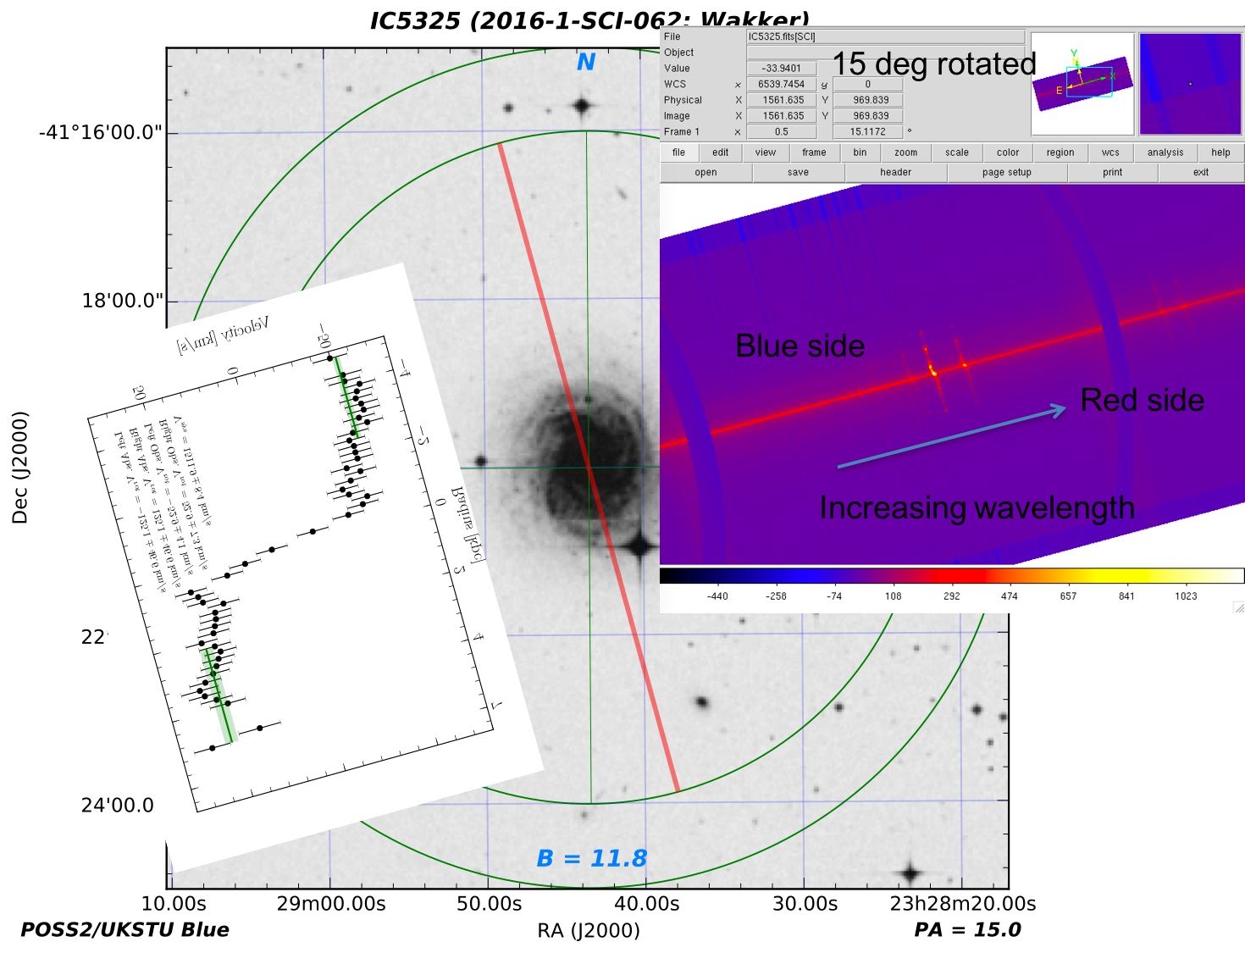
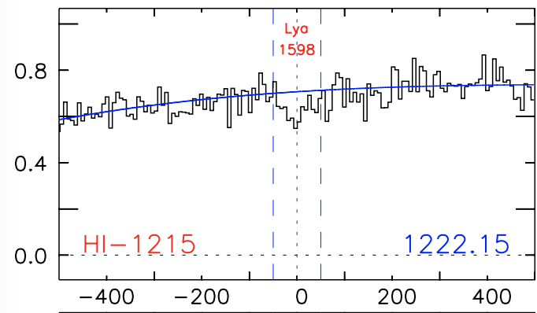
-53 km/s
+53 km/s
dv = +95 km/s
Notes:
Correct (11/20/17)

Slide 5
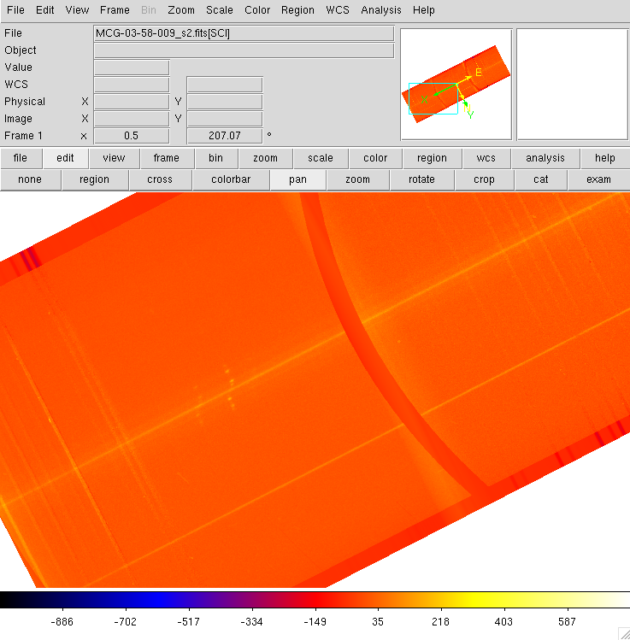
blue
red
Increasing wavelength
Notes:
Correct (11/20/17)

Slide 6
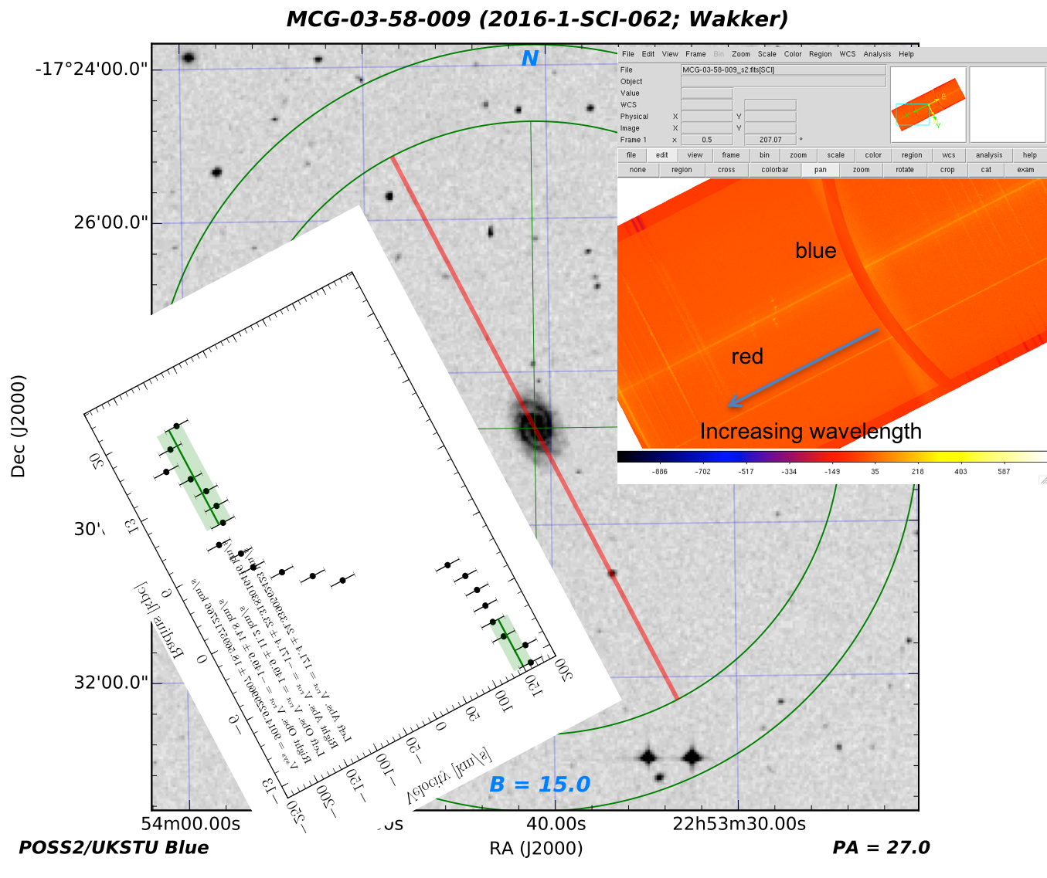
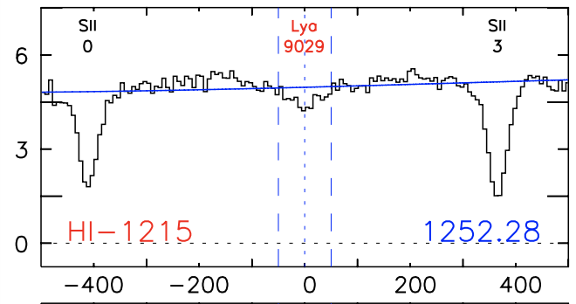
-150 km/s
dv = -1 km/s
+150 km/s
Notes:
Correct (11/20/17)

Slide 7
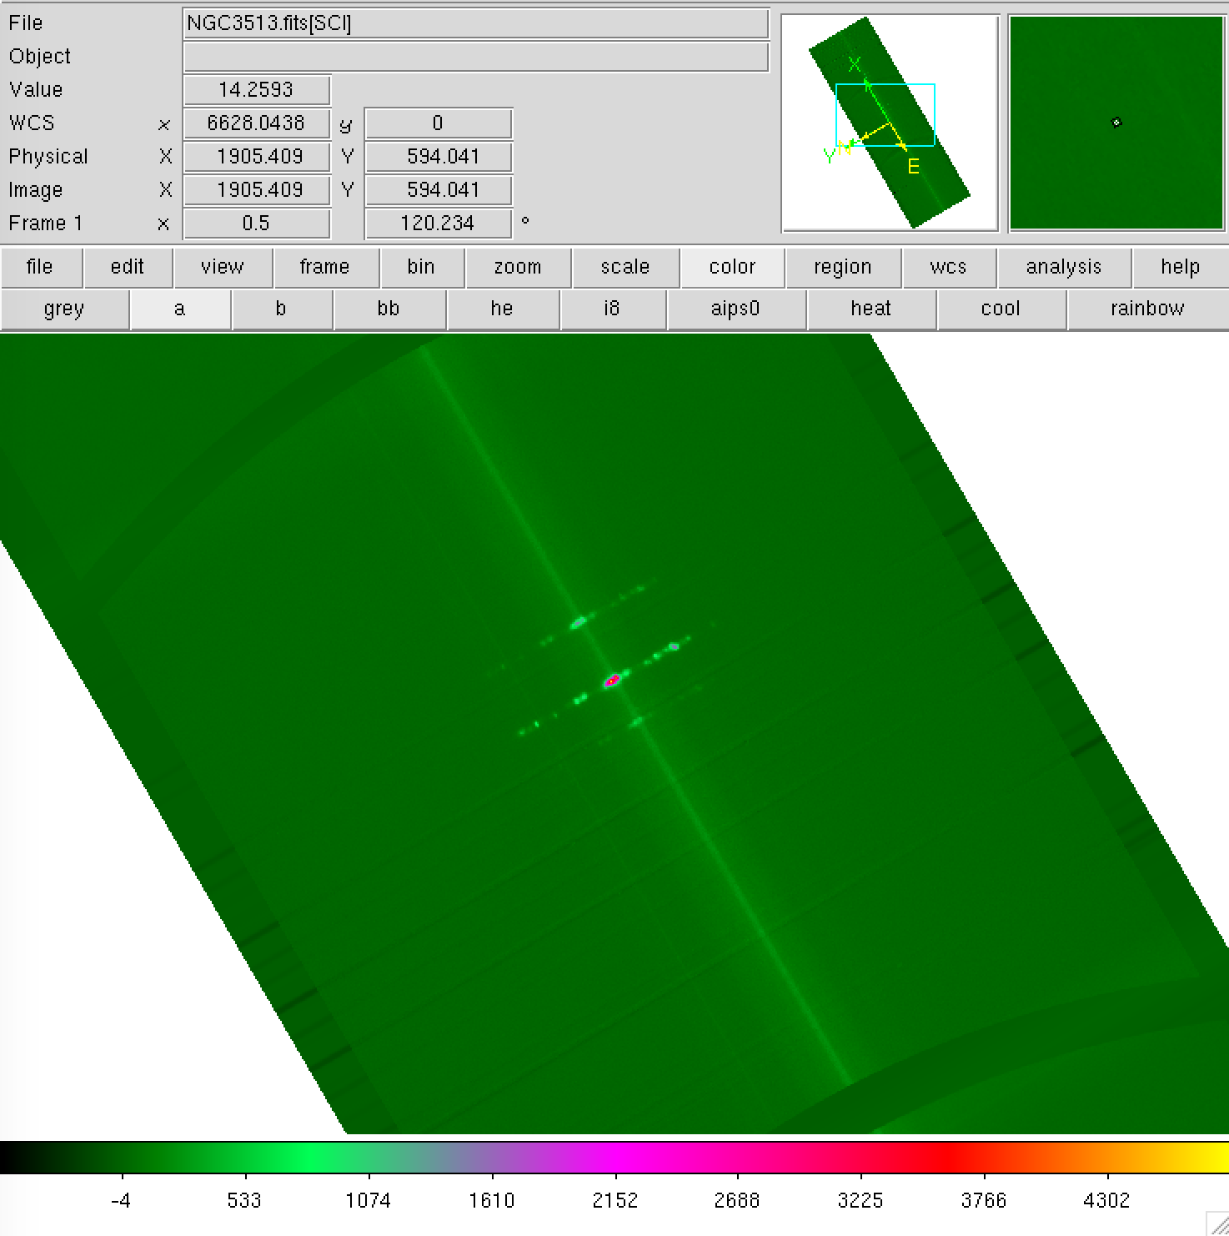
Increasing wavelength
Blue side
Red side
Notes:
Correct (11/20/17)

Slide 8
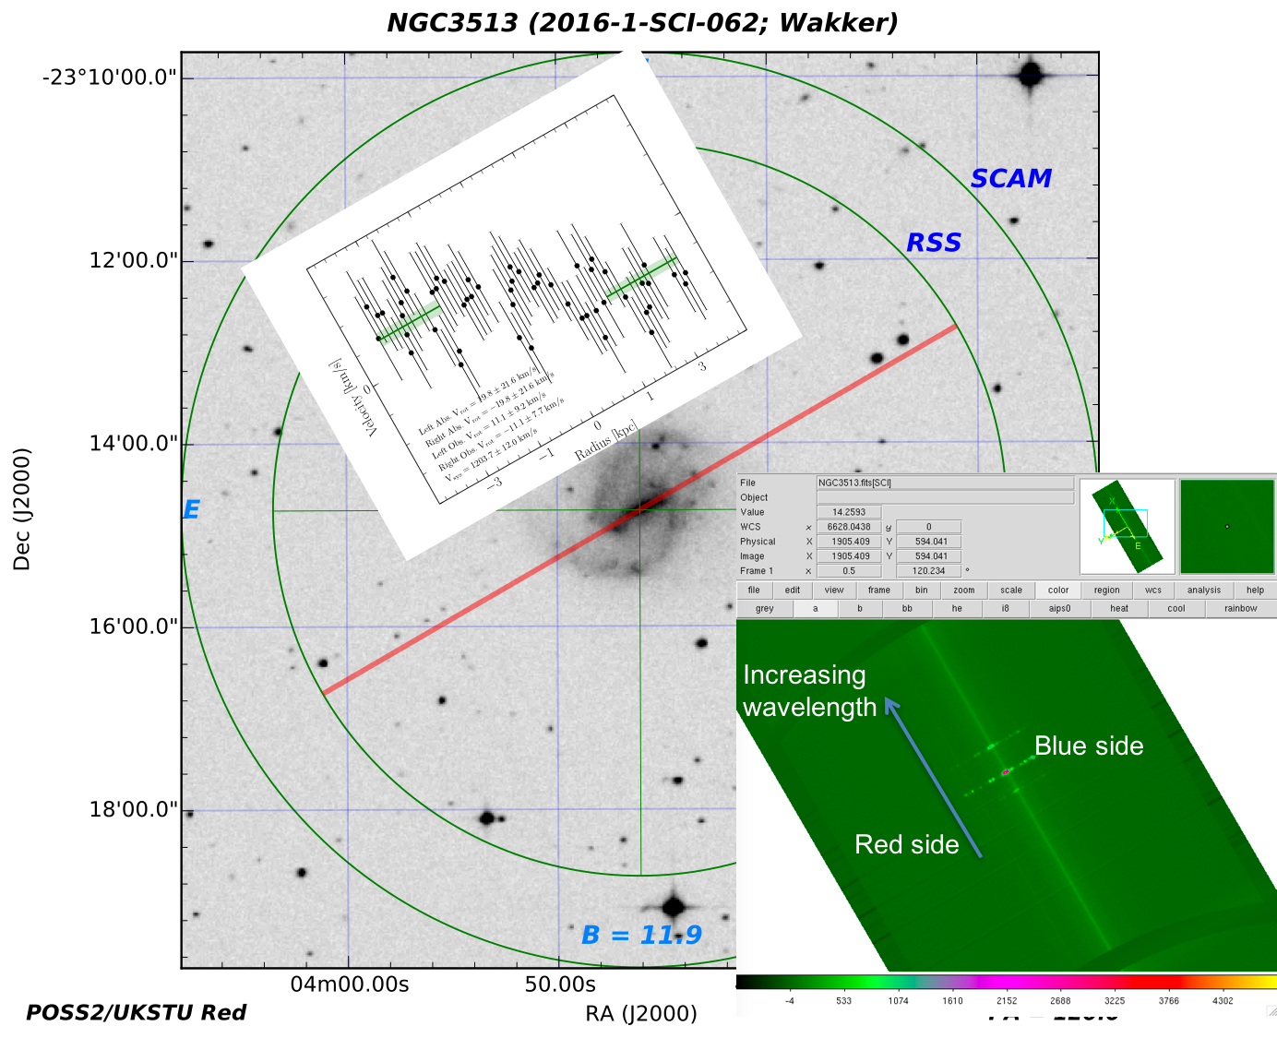
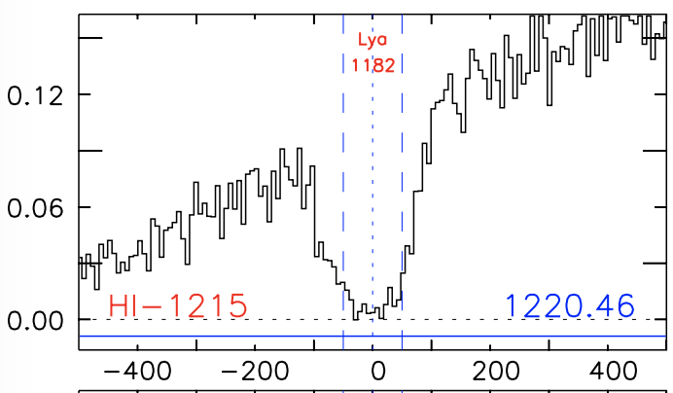
-11 km/s
+11 km/s
dv = -12 km/s
Notes:
Correct (11/20/17)

Slide 9
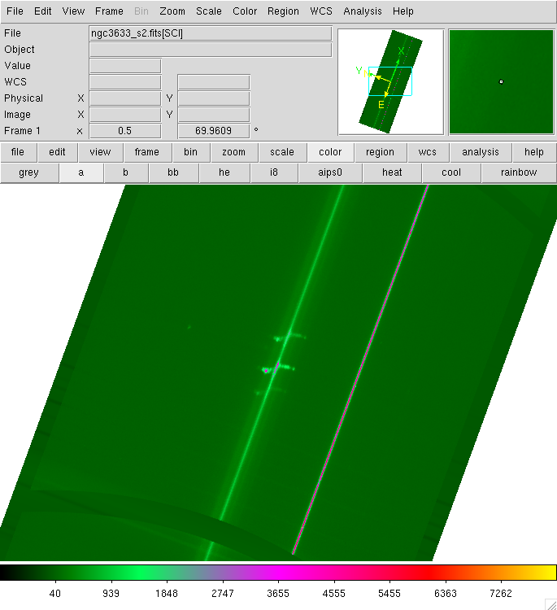
Increasing wavelength
Red side
Blue side
Notes:
This should be correct (11/20/17)

Slide 10
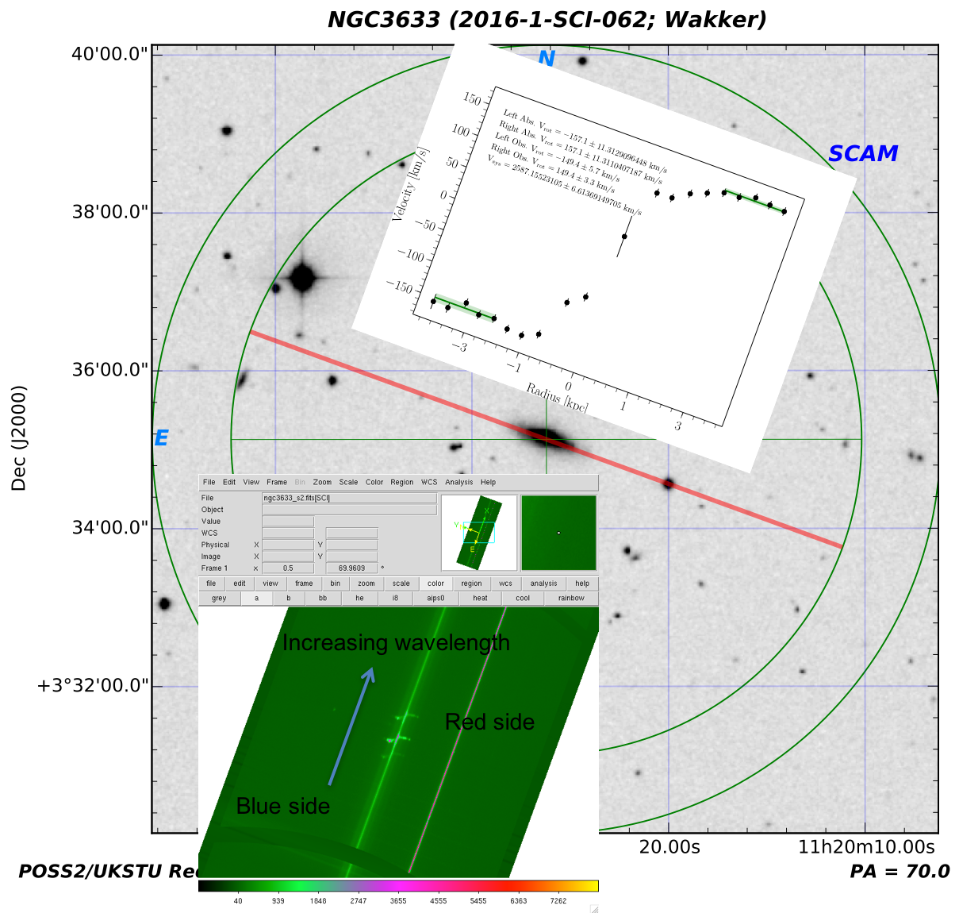
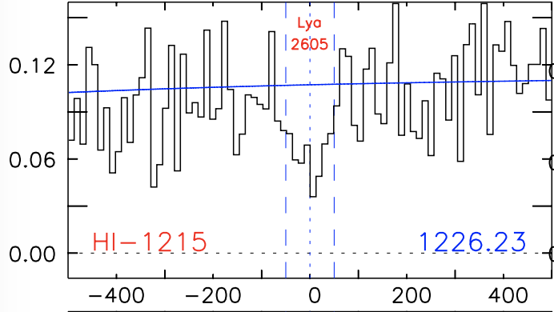
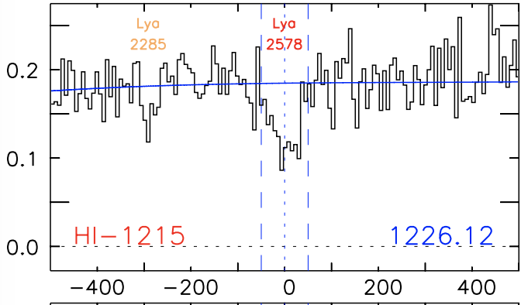
-149 km/s
+149 km/s
dv = +5 km/s
dv = -22 km/s
dv = -315 kms/
Notes:
This should be correct (11/20/17)

Slide 11
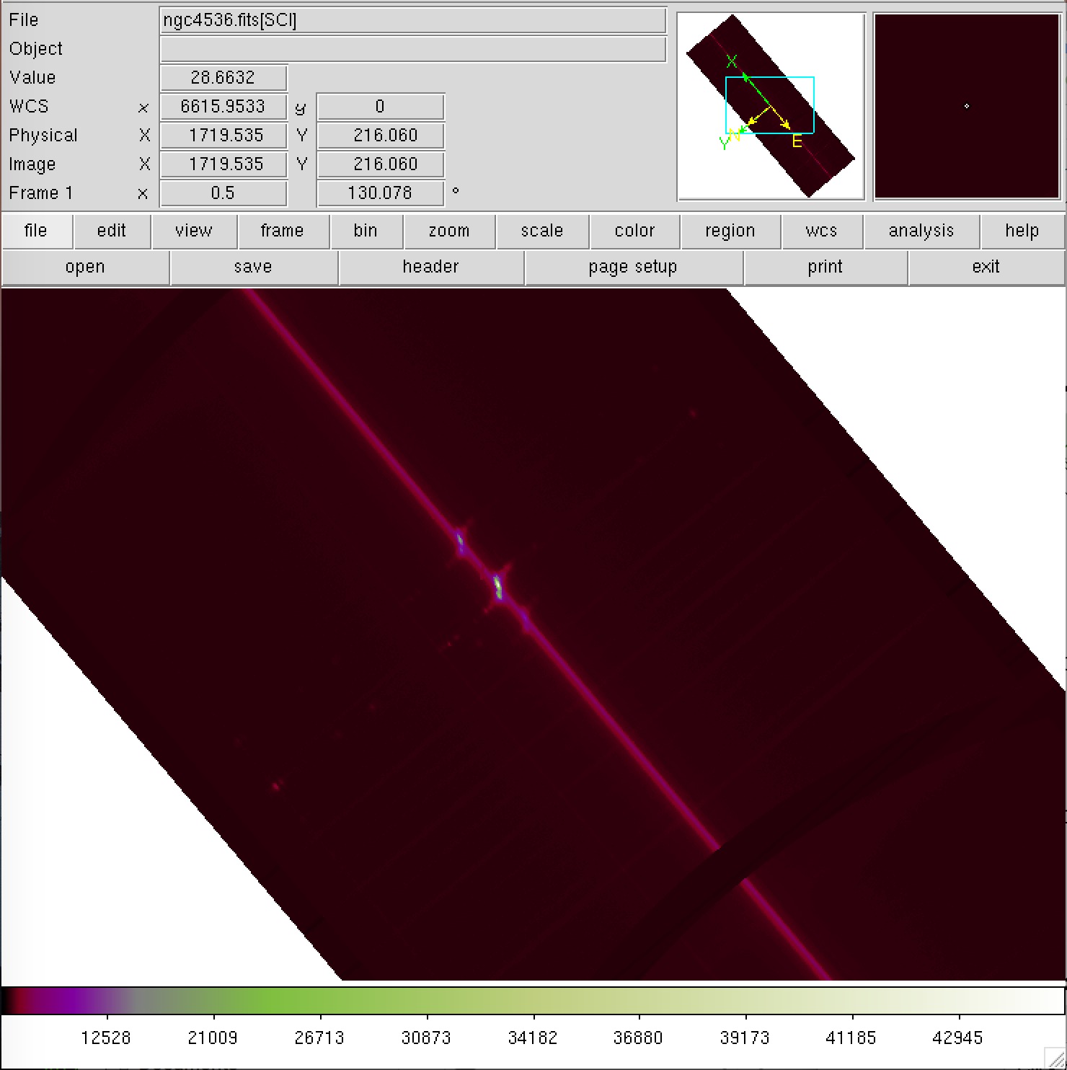
Increasing wavelength
Red side
Blue side
Notes:
Correct (11/20/17)

Slide 12
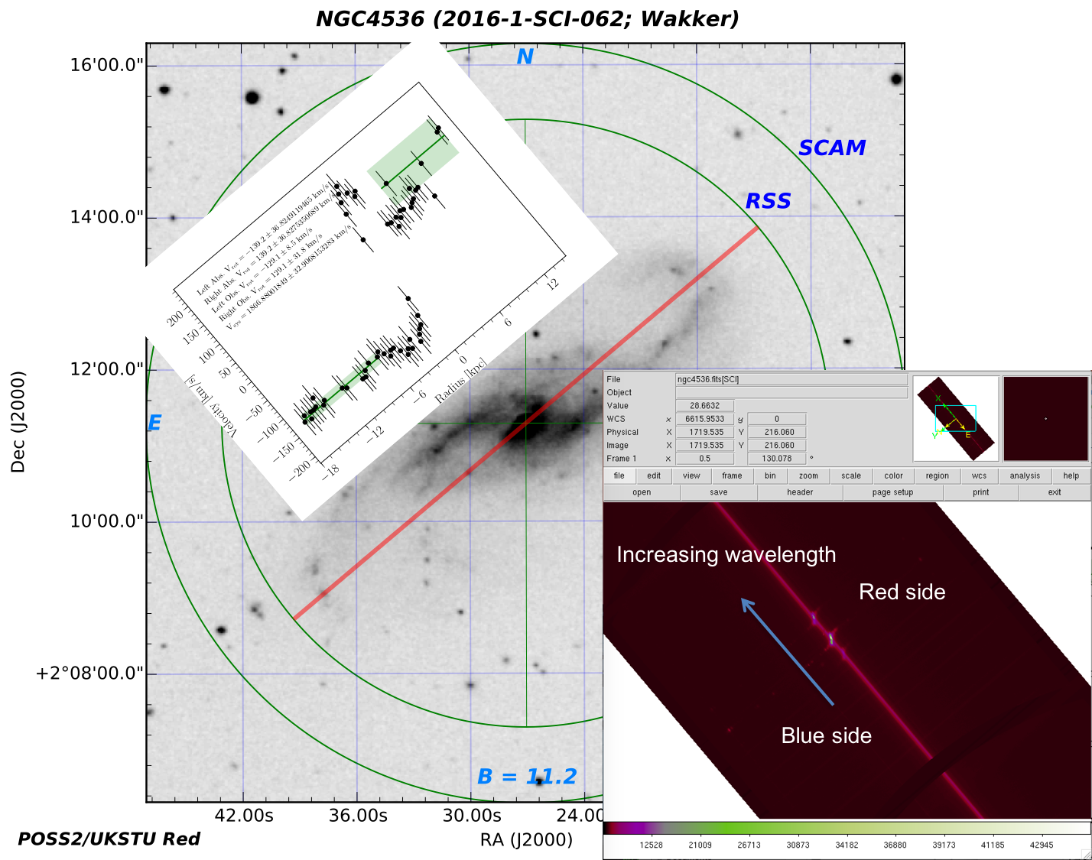
Notes:
Correct (11/20/17)

Slide 13
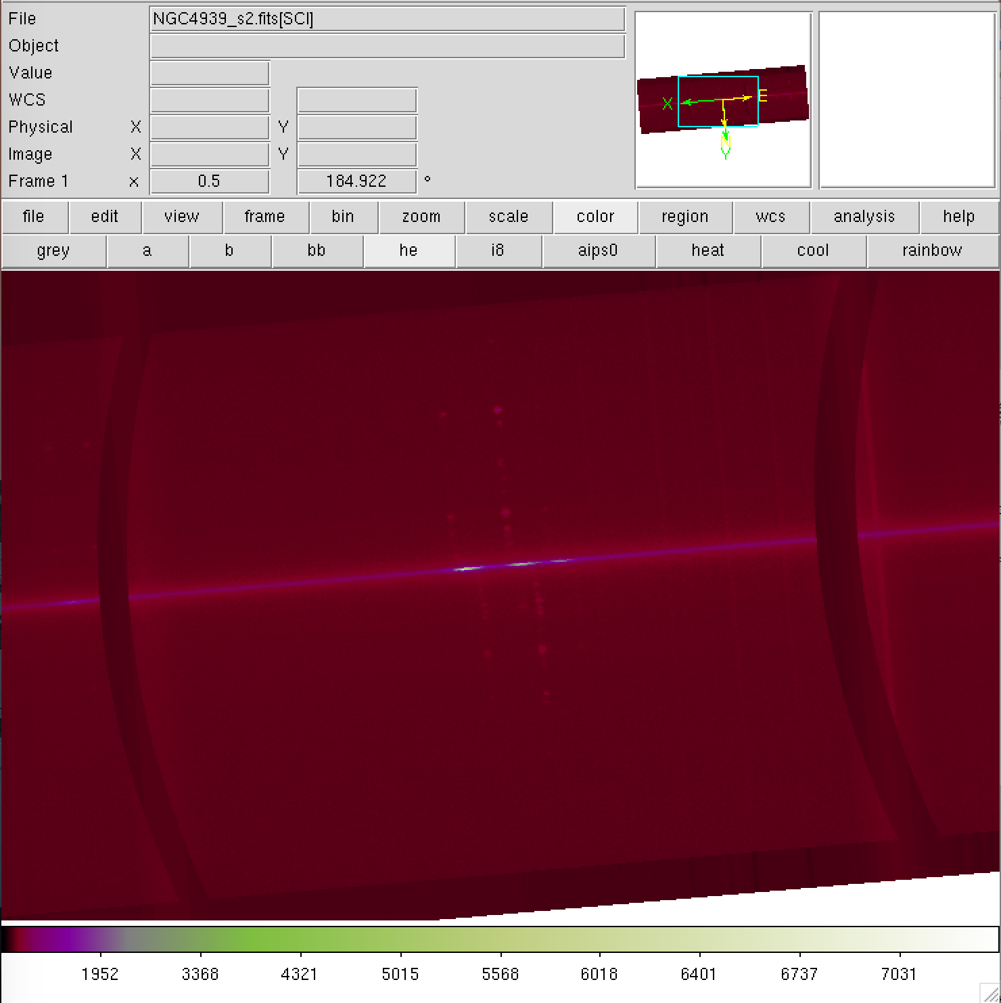
red
blue
Increasing wavelength
Notes:
Probably correct (11/20/17)

Slide 14
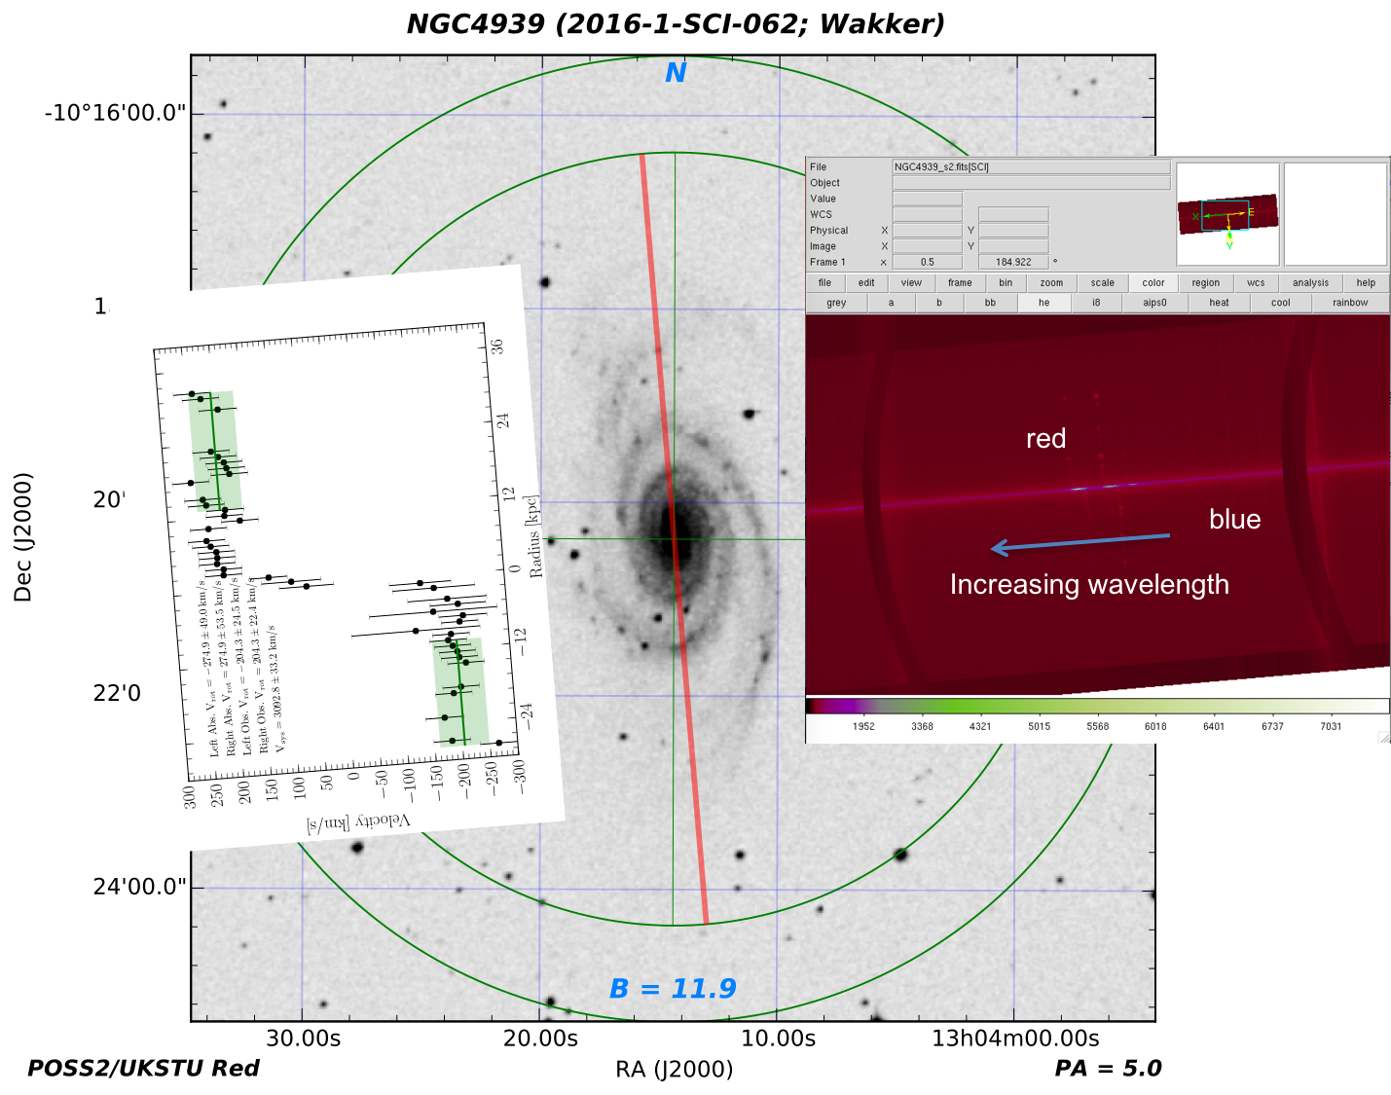
+204 km/s
-204 km/s
Notes:
Probably correct (11/20/17)

Slide 15
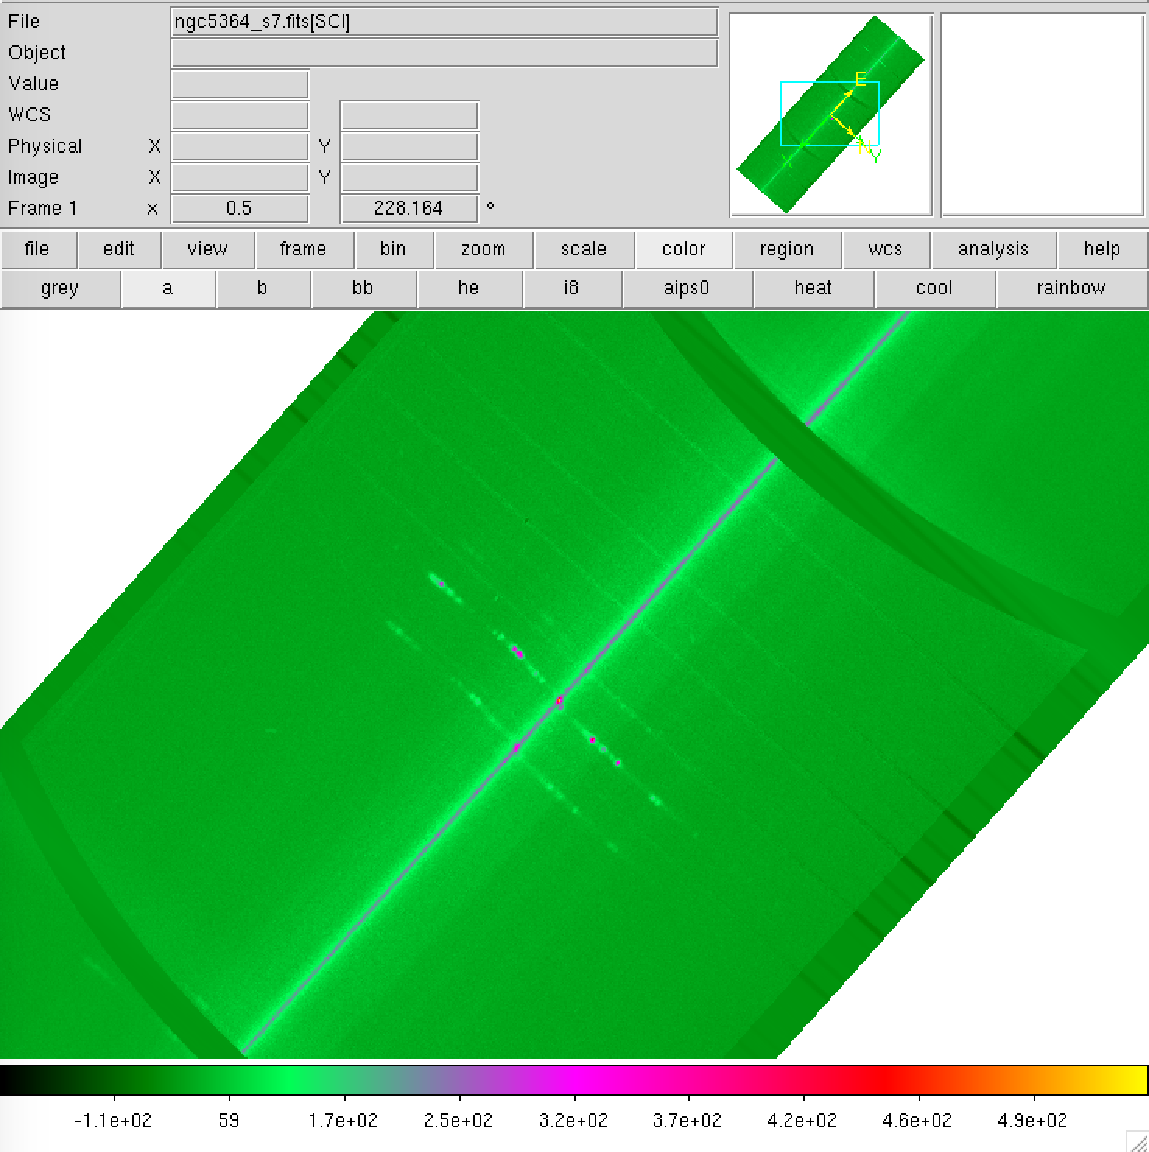
Blue side
Red side
Increasing wavelength

Slide 16
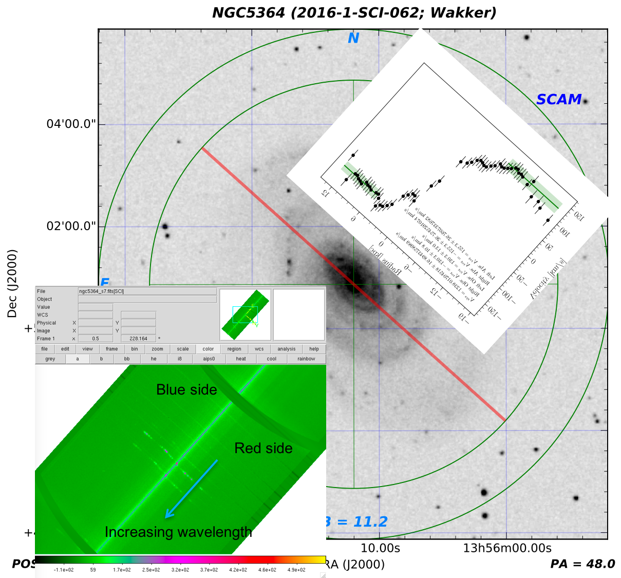

Slide 17
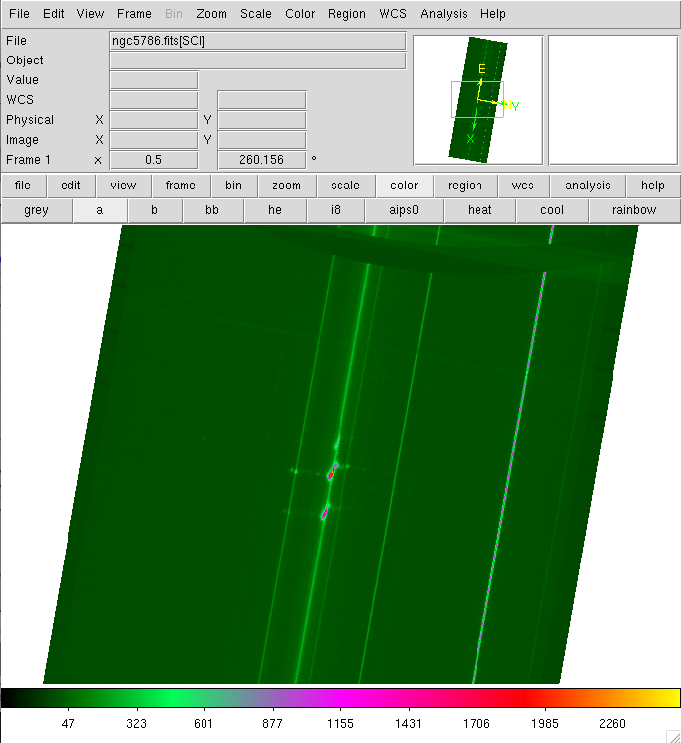
Red side
Blue side
Increasing wavelength
Notes:
This should be correct (11/20/17)

Slide 18
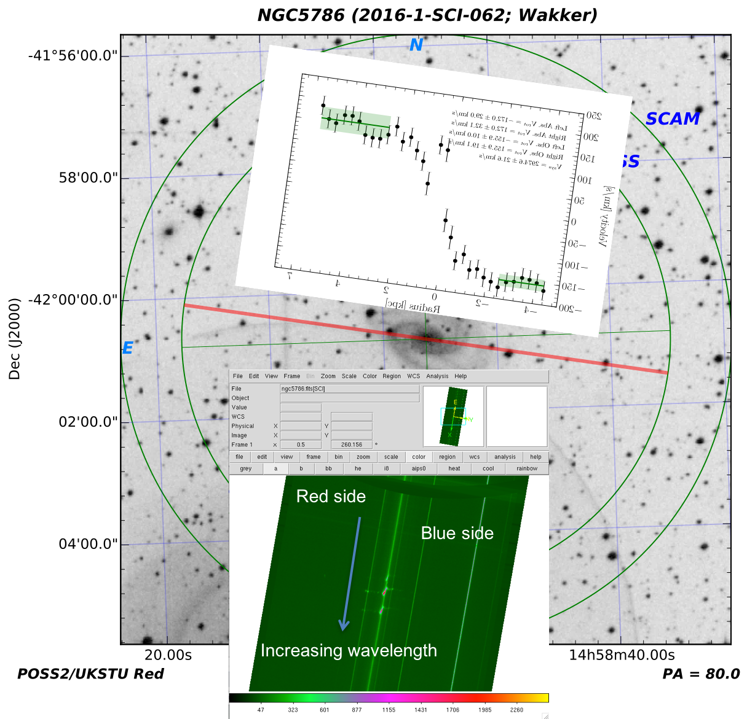
Notes:
This should be correct (11/20/17)

Slide 19
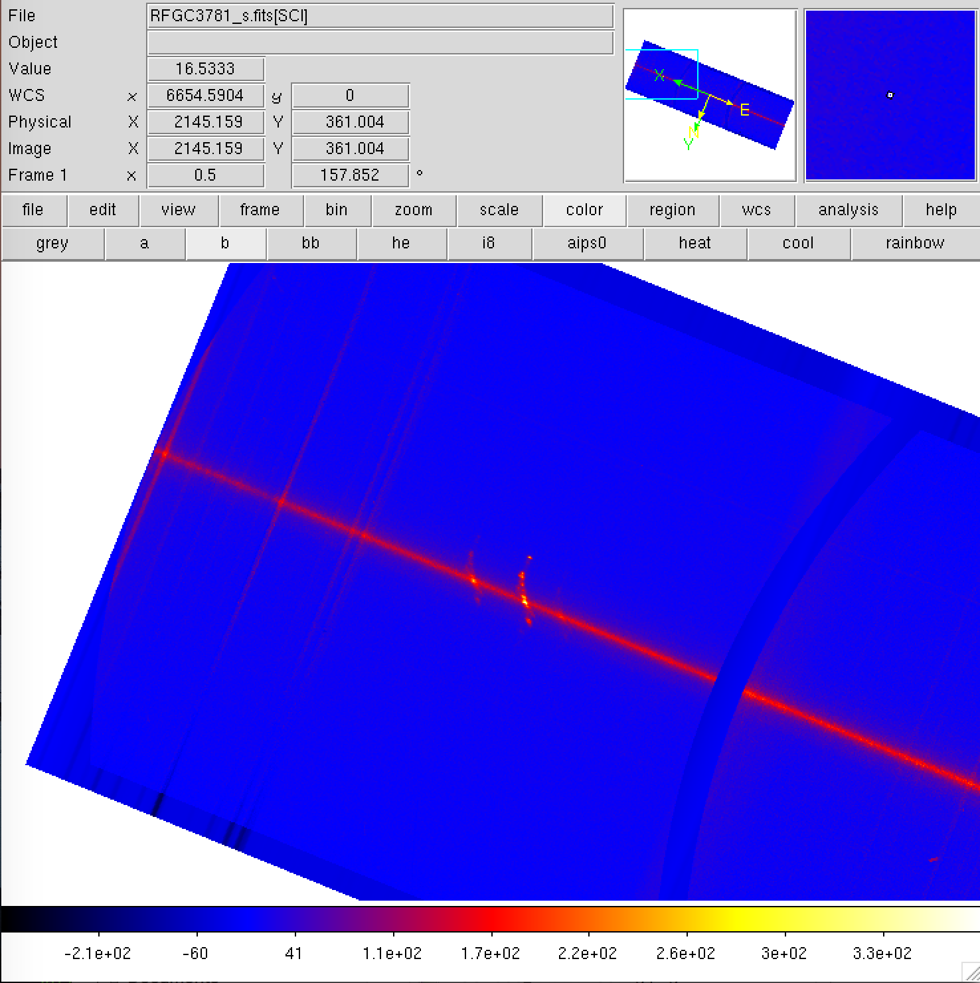
Red side
Blue side
Increasing wavelength
Notes:
Correct (11/20/17)

Slide 20
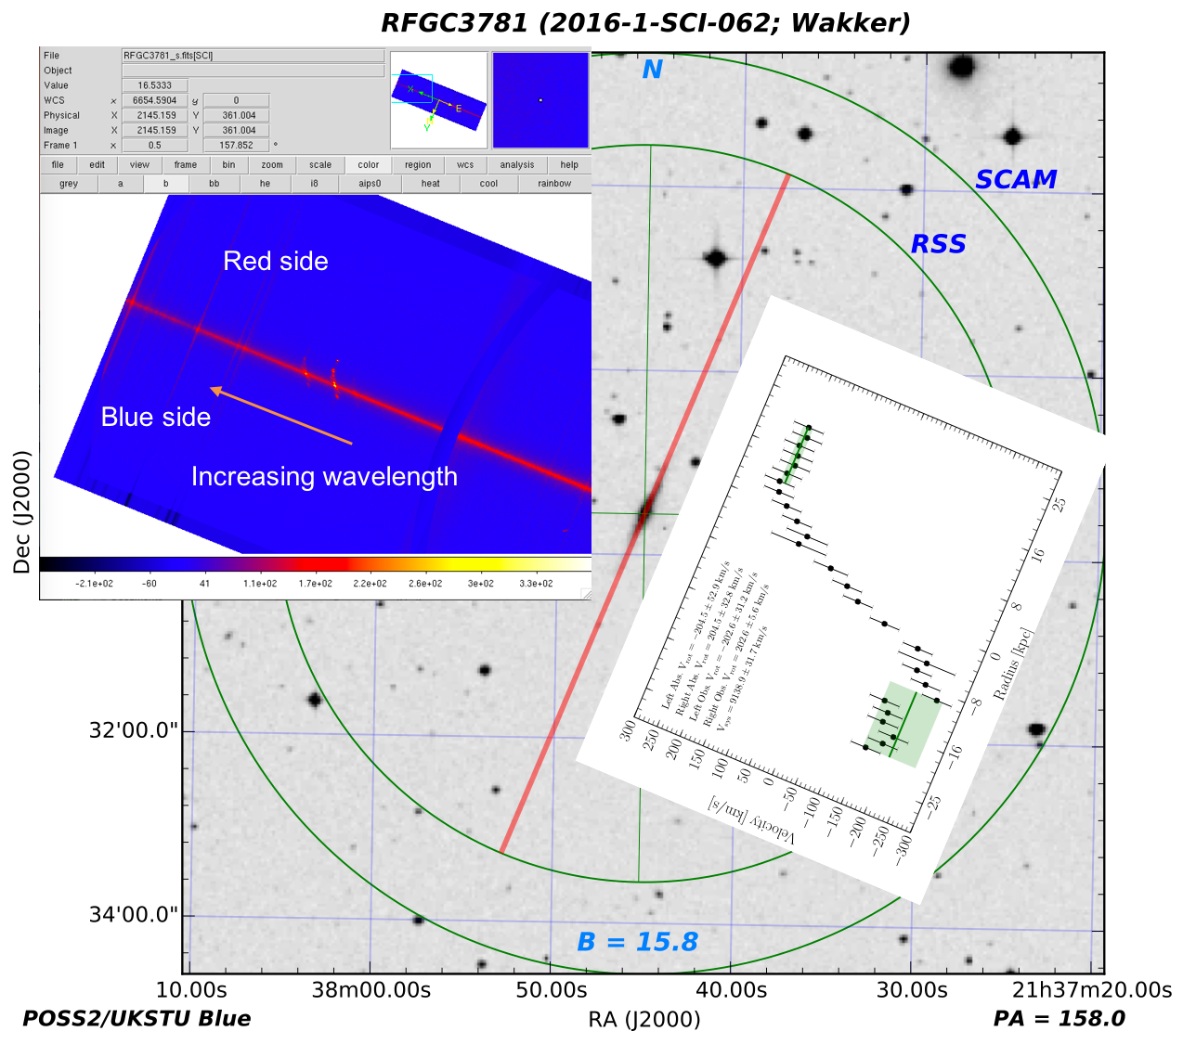
Notes:
Correct (11/20/17)

Slide 21
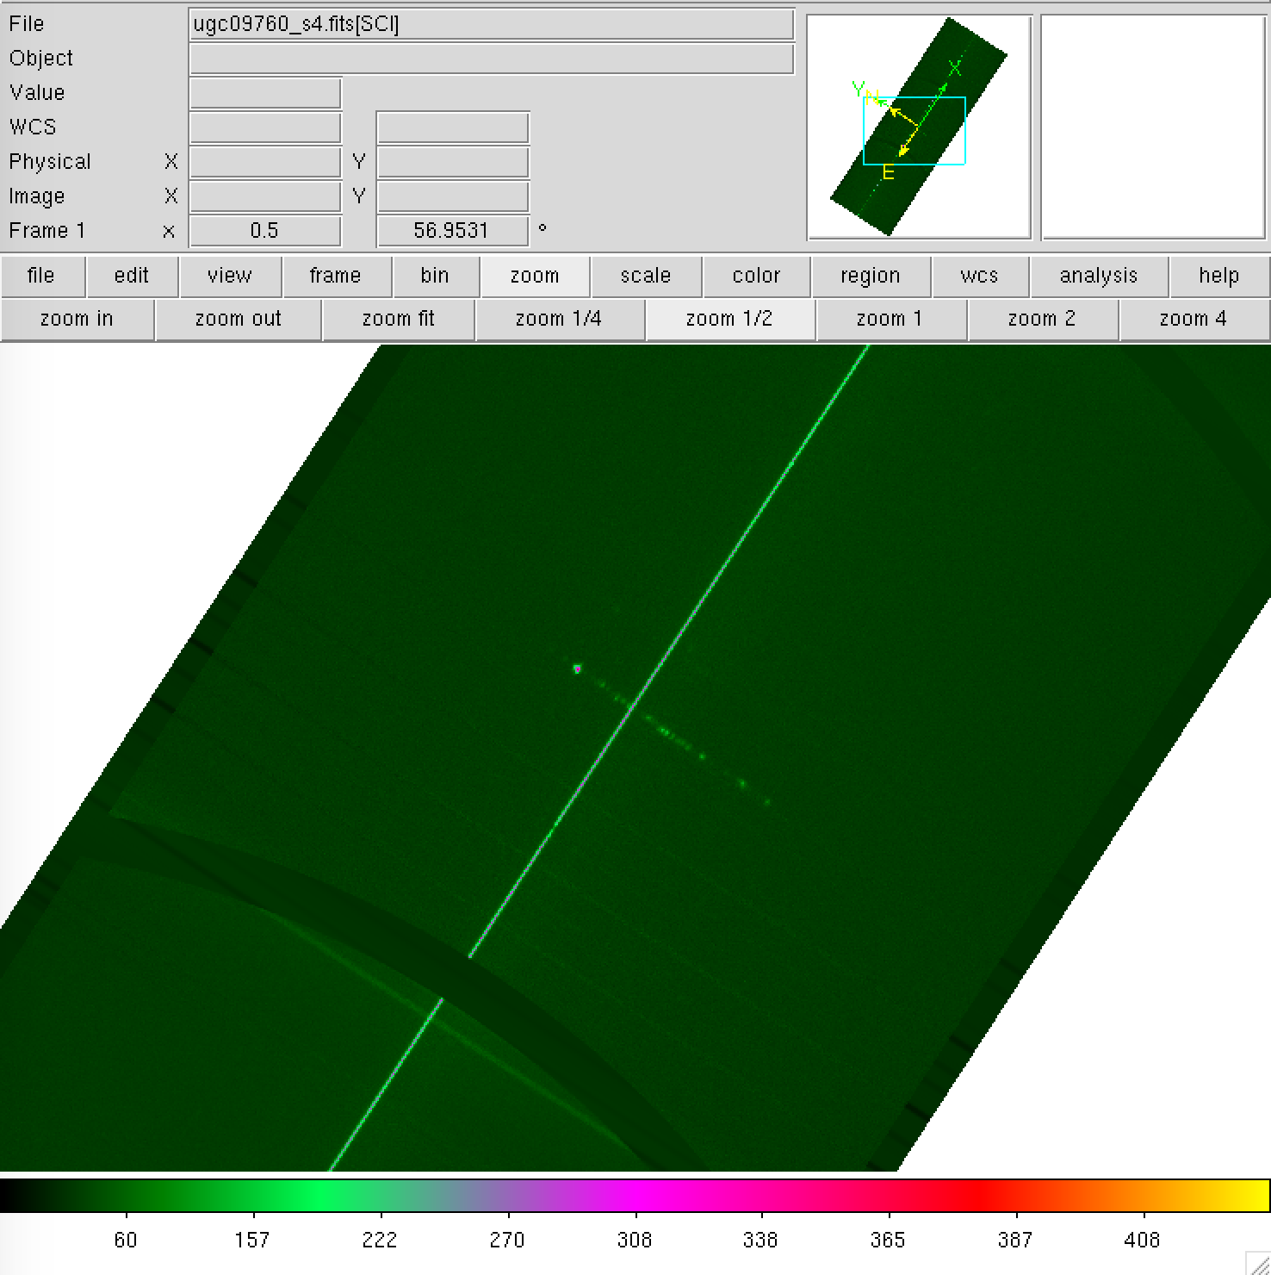
Increasing wavelength
Red side
Blue side
Notes:
Correct (11/20/17)

Slide 22
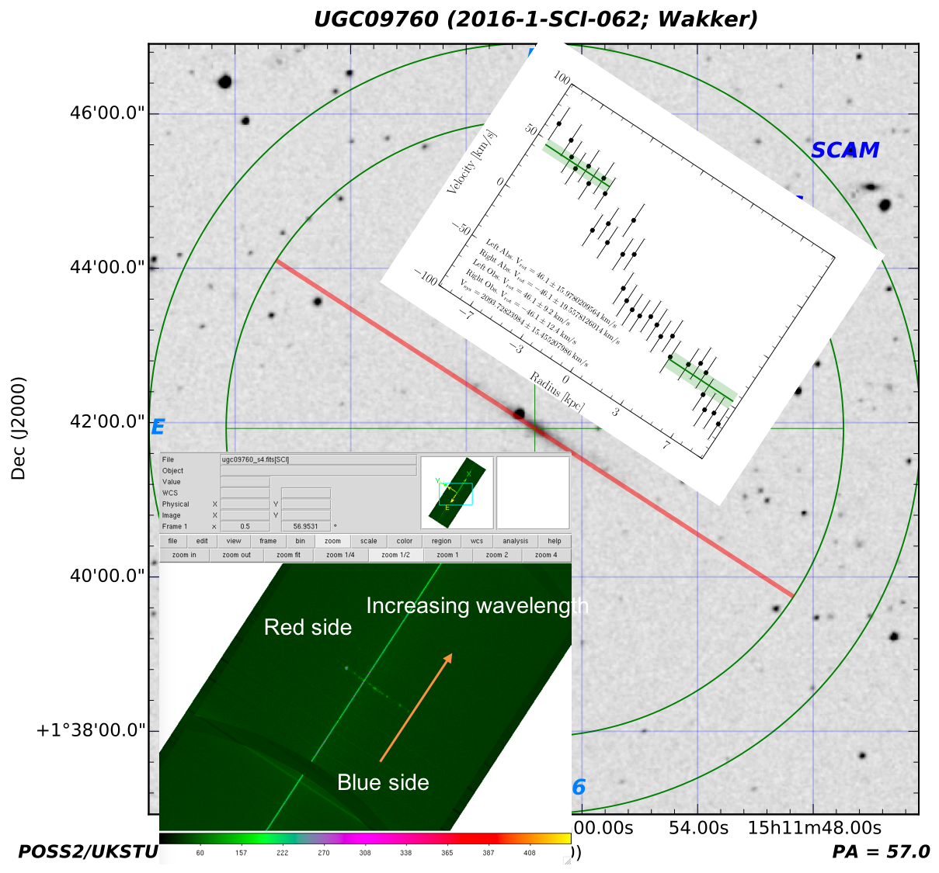
Notes:
Correct (11/20/17)

Slide 23
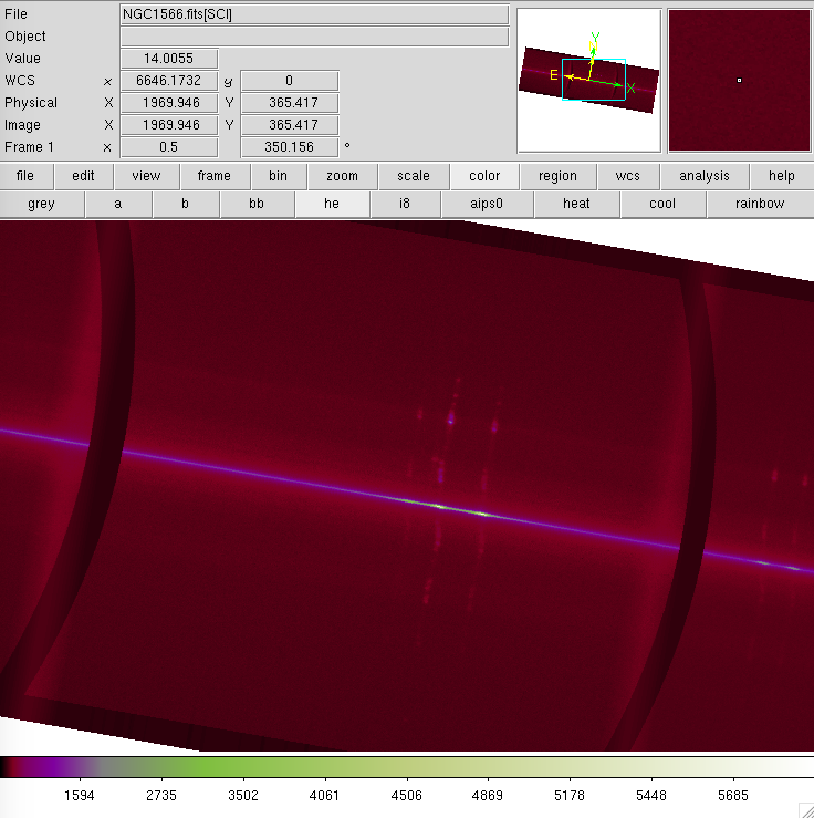
Increasing wavelength
Blue side
Red side
Notes:
Correct (11/20/17)

Slide 24
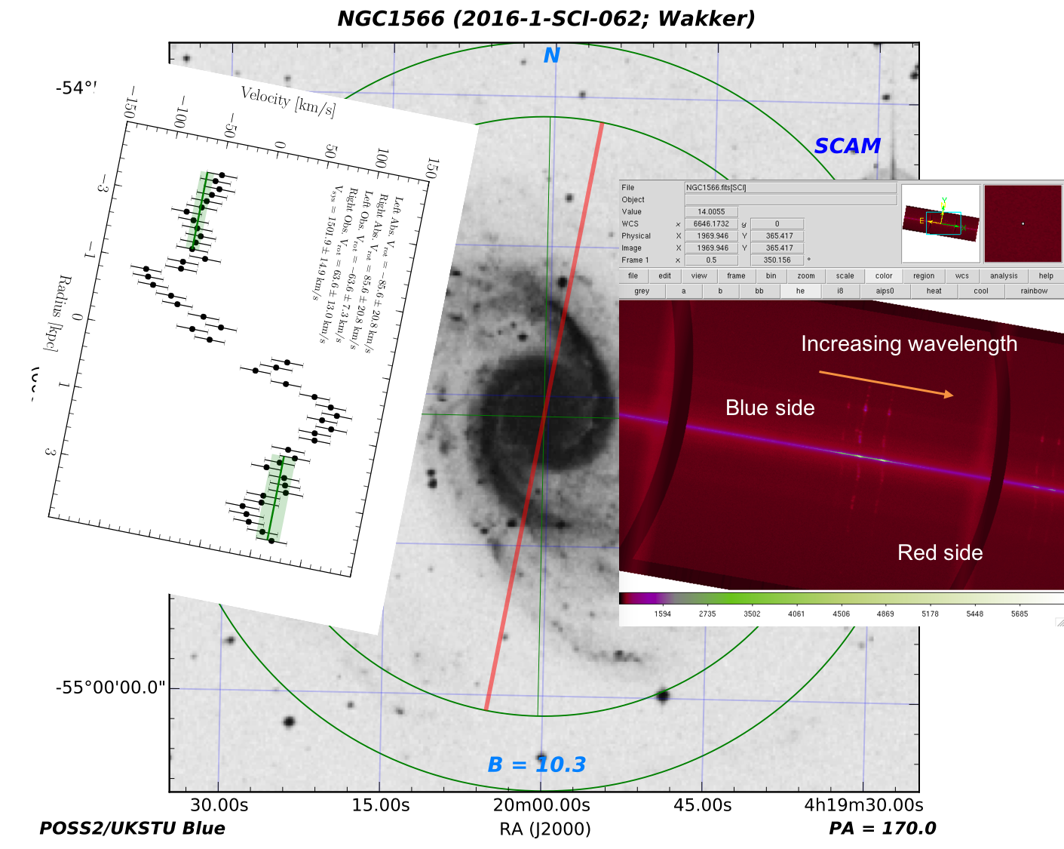
Notes:
Correct (11/20/17)

